Slide 1
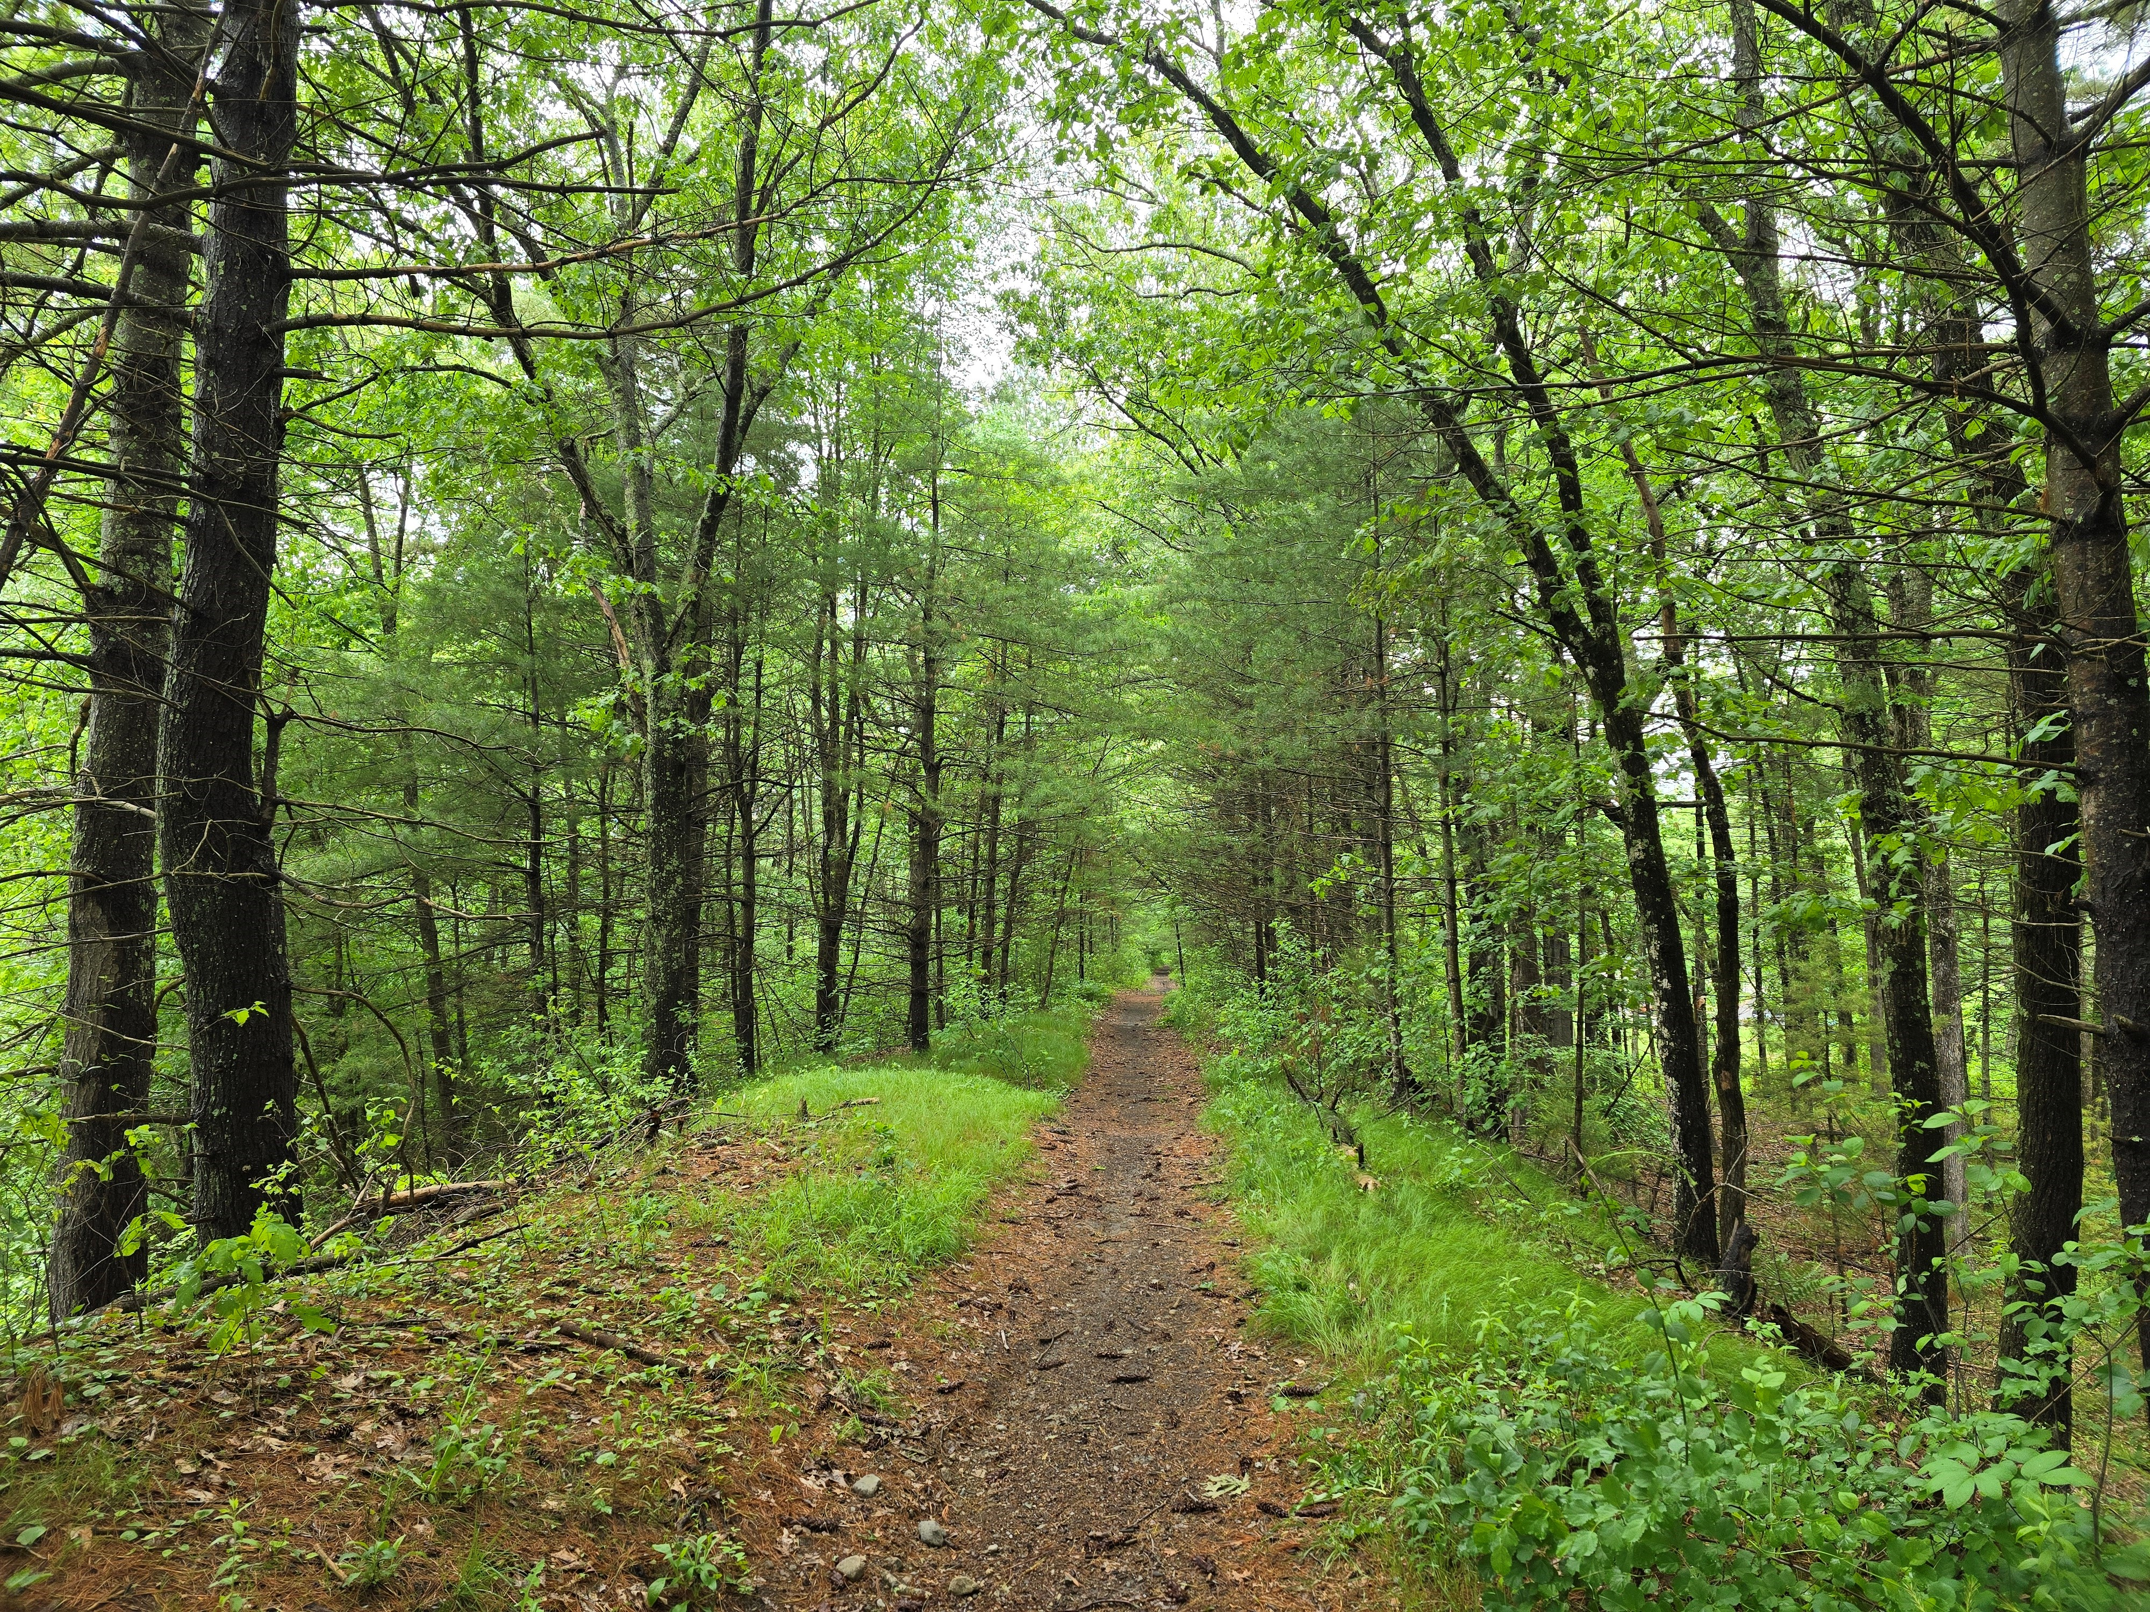
Charles Headwaters Greenway
Updates

Slide 2
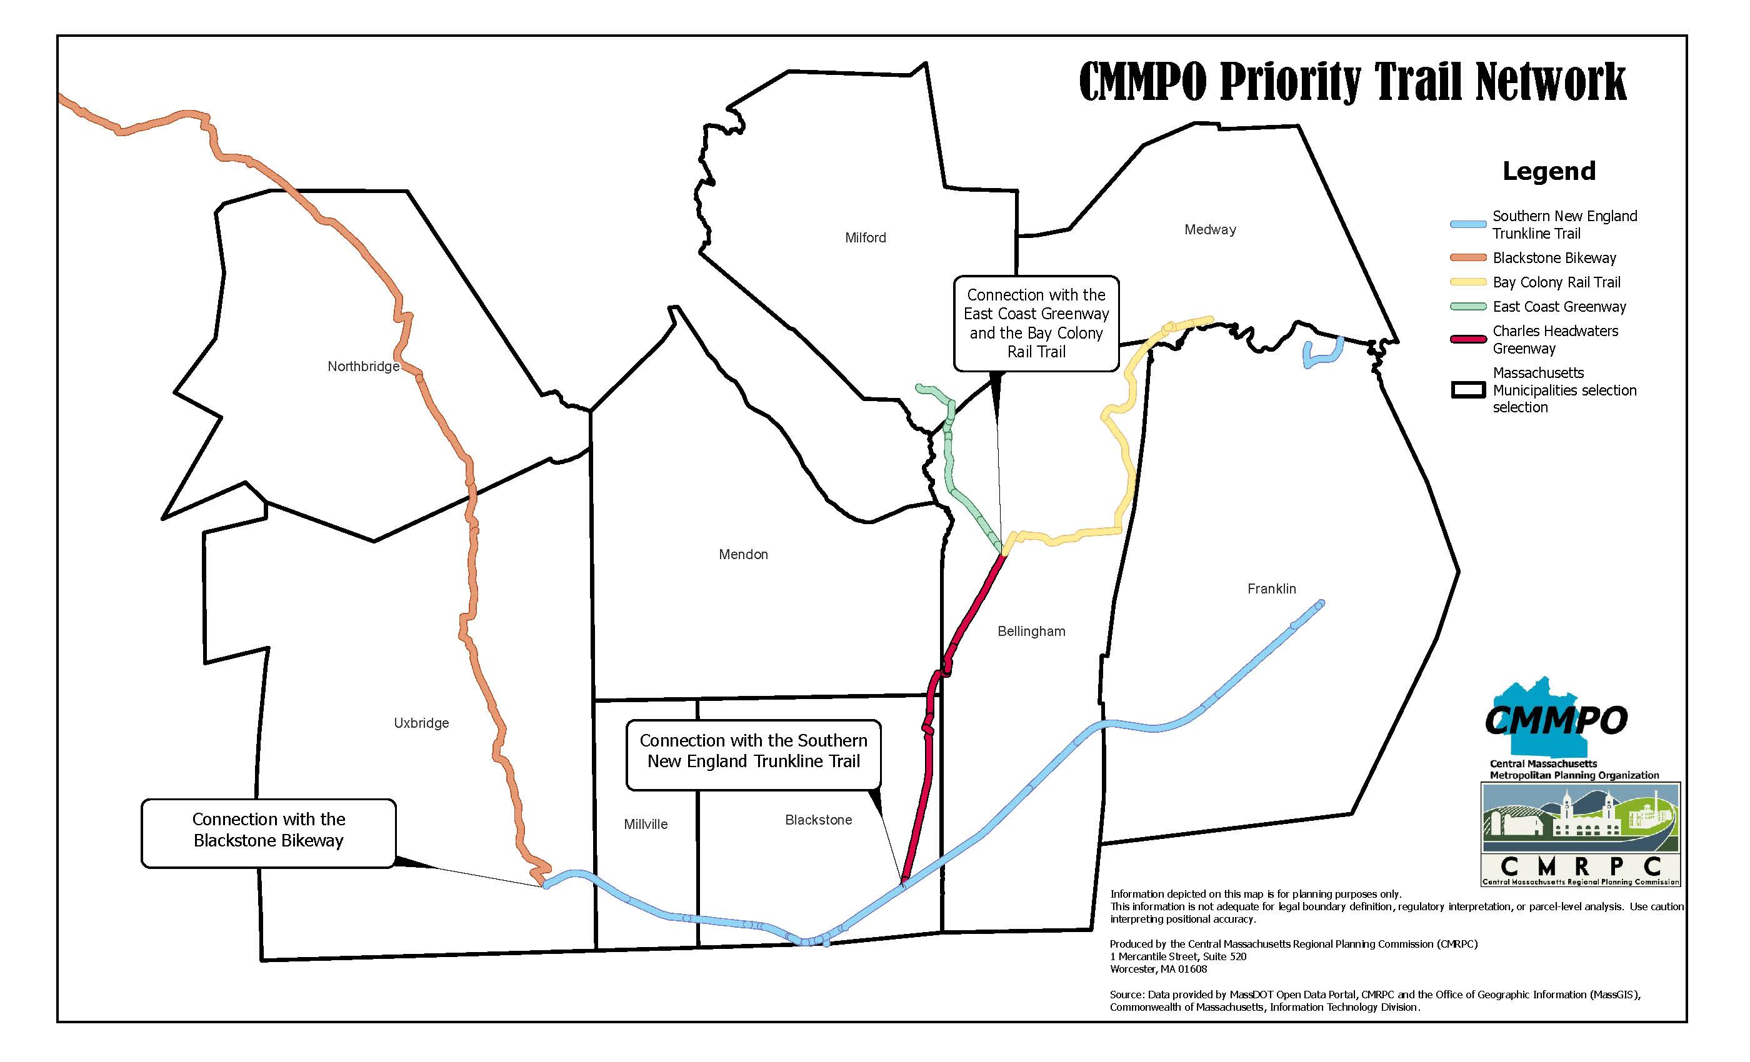

Slide 3
Background
Trail | Length
Charles Headwaters Greenway | 8-10 Miles
Upper Charles Trail | 13.9 Miles
East Coast Greenway | 56 Miles in MA
Blackstone River Bikeway | 24 Miles (Projected 48)
Southern New England Trunkline Trail (SNETT) | 22 Miles
Old Bay Colony Railbed
8-10 Miles connecting Blackstone to Bellingham
Connecting 5 major trails together.
Builds upon the MassDOT Priority Trail Network

Slide 4
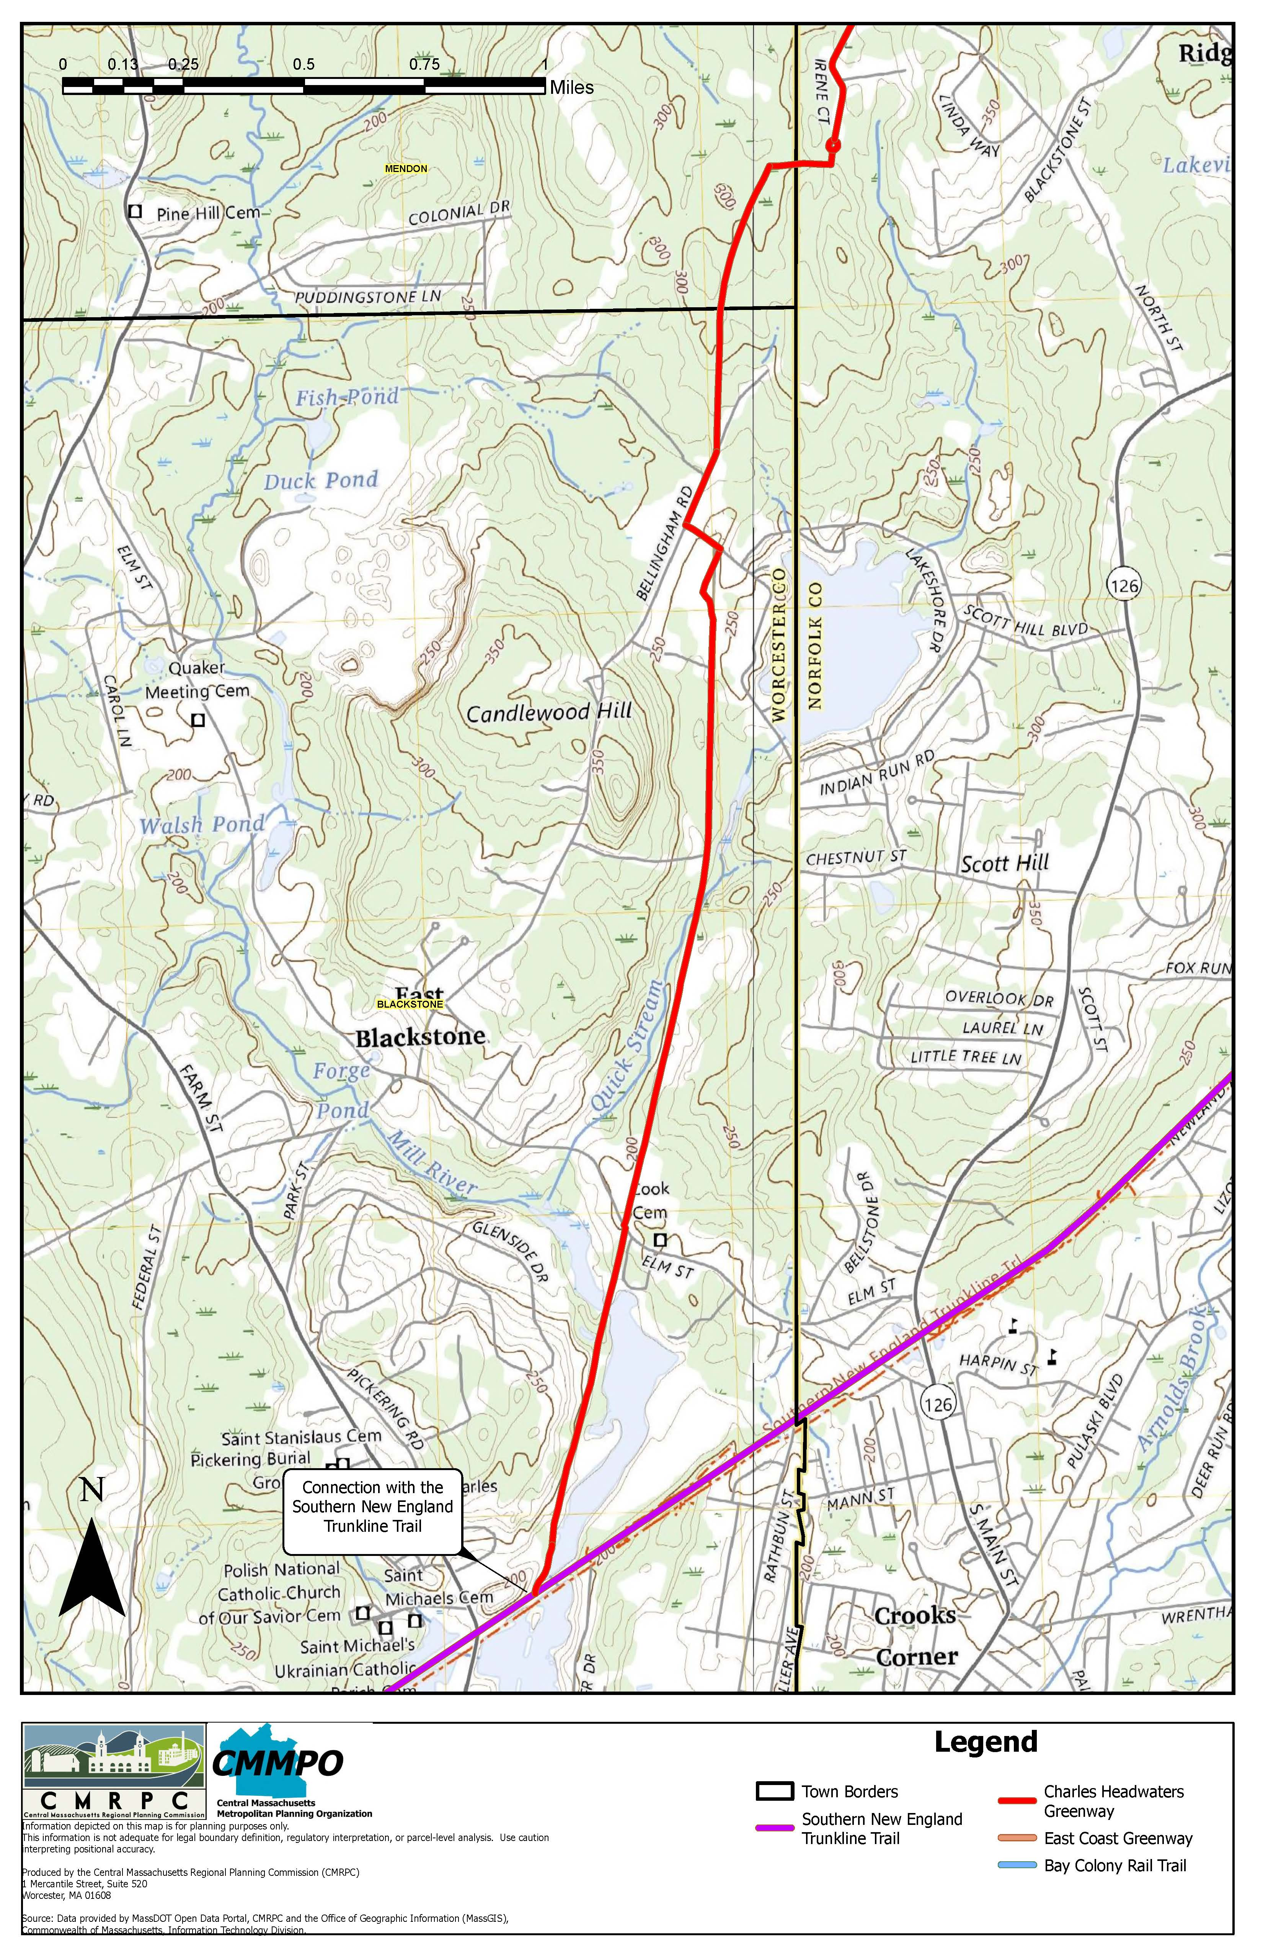
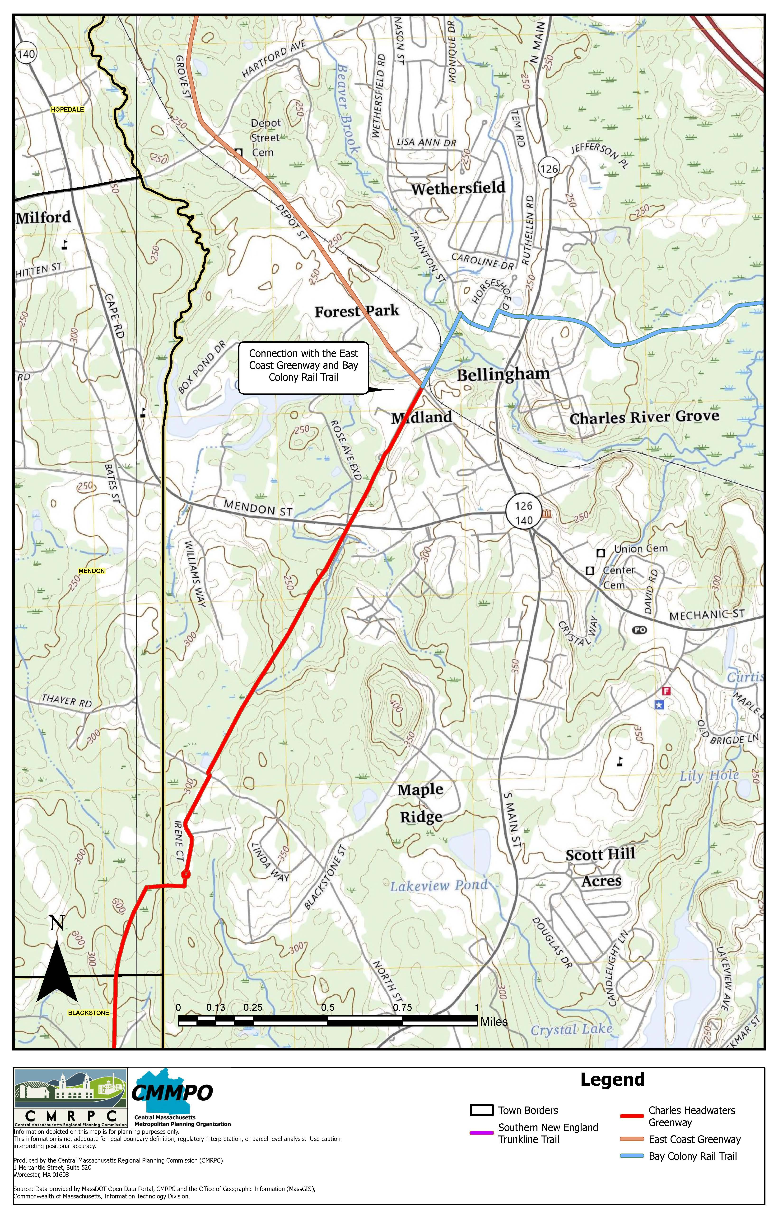

Slide 5
Goals of the CHG
Better connect the communities to existing greenways, including the Milford Upper Charles Trail, The SNETT trail and Blackstone Valley.
Preserve and reconnect where possible the abandoned Old Colony Railroad ROW that runs.
Provide the opportunity for a continuous greenway corridor through Massachusetts connecting to Rhode Island where the East Coast Greenway can be routed.
Connect public transit locations, particularly two Commuter Rail stations in Franklin.

Slide 6
Recent Updates
Project Steering Committee chose Bowman.
Project started in April.
Recurring Monthly Meetings
Comprehensive site visit on June 3rd.

Slide 7
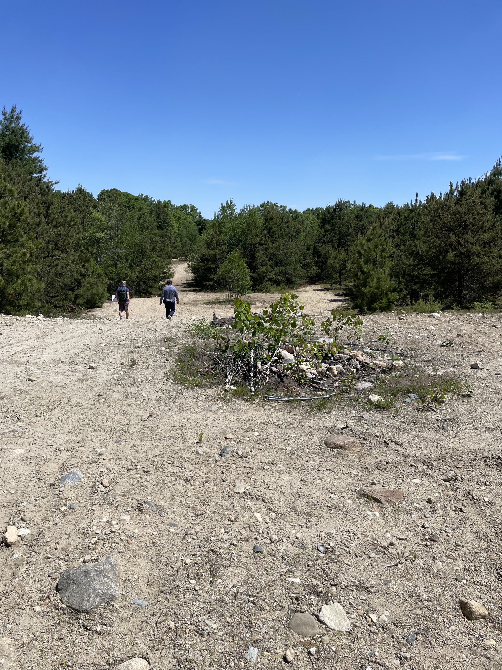
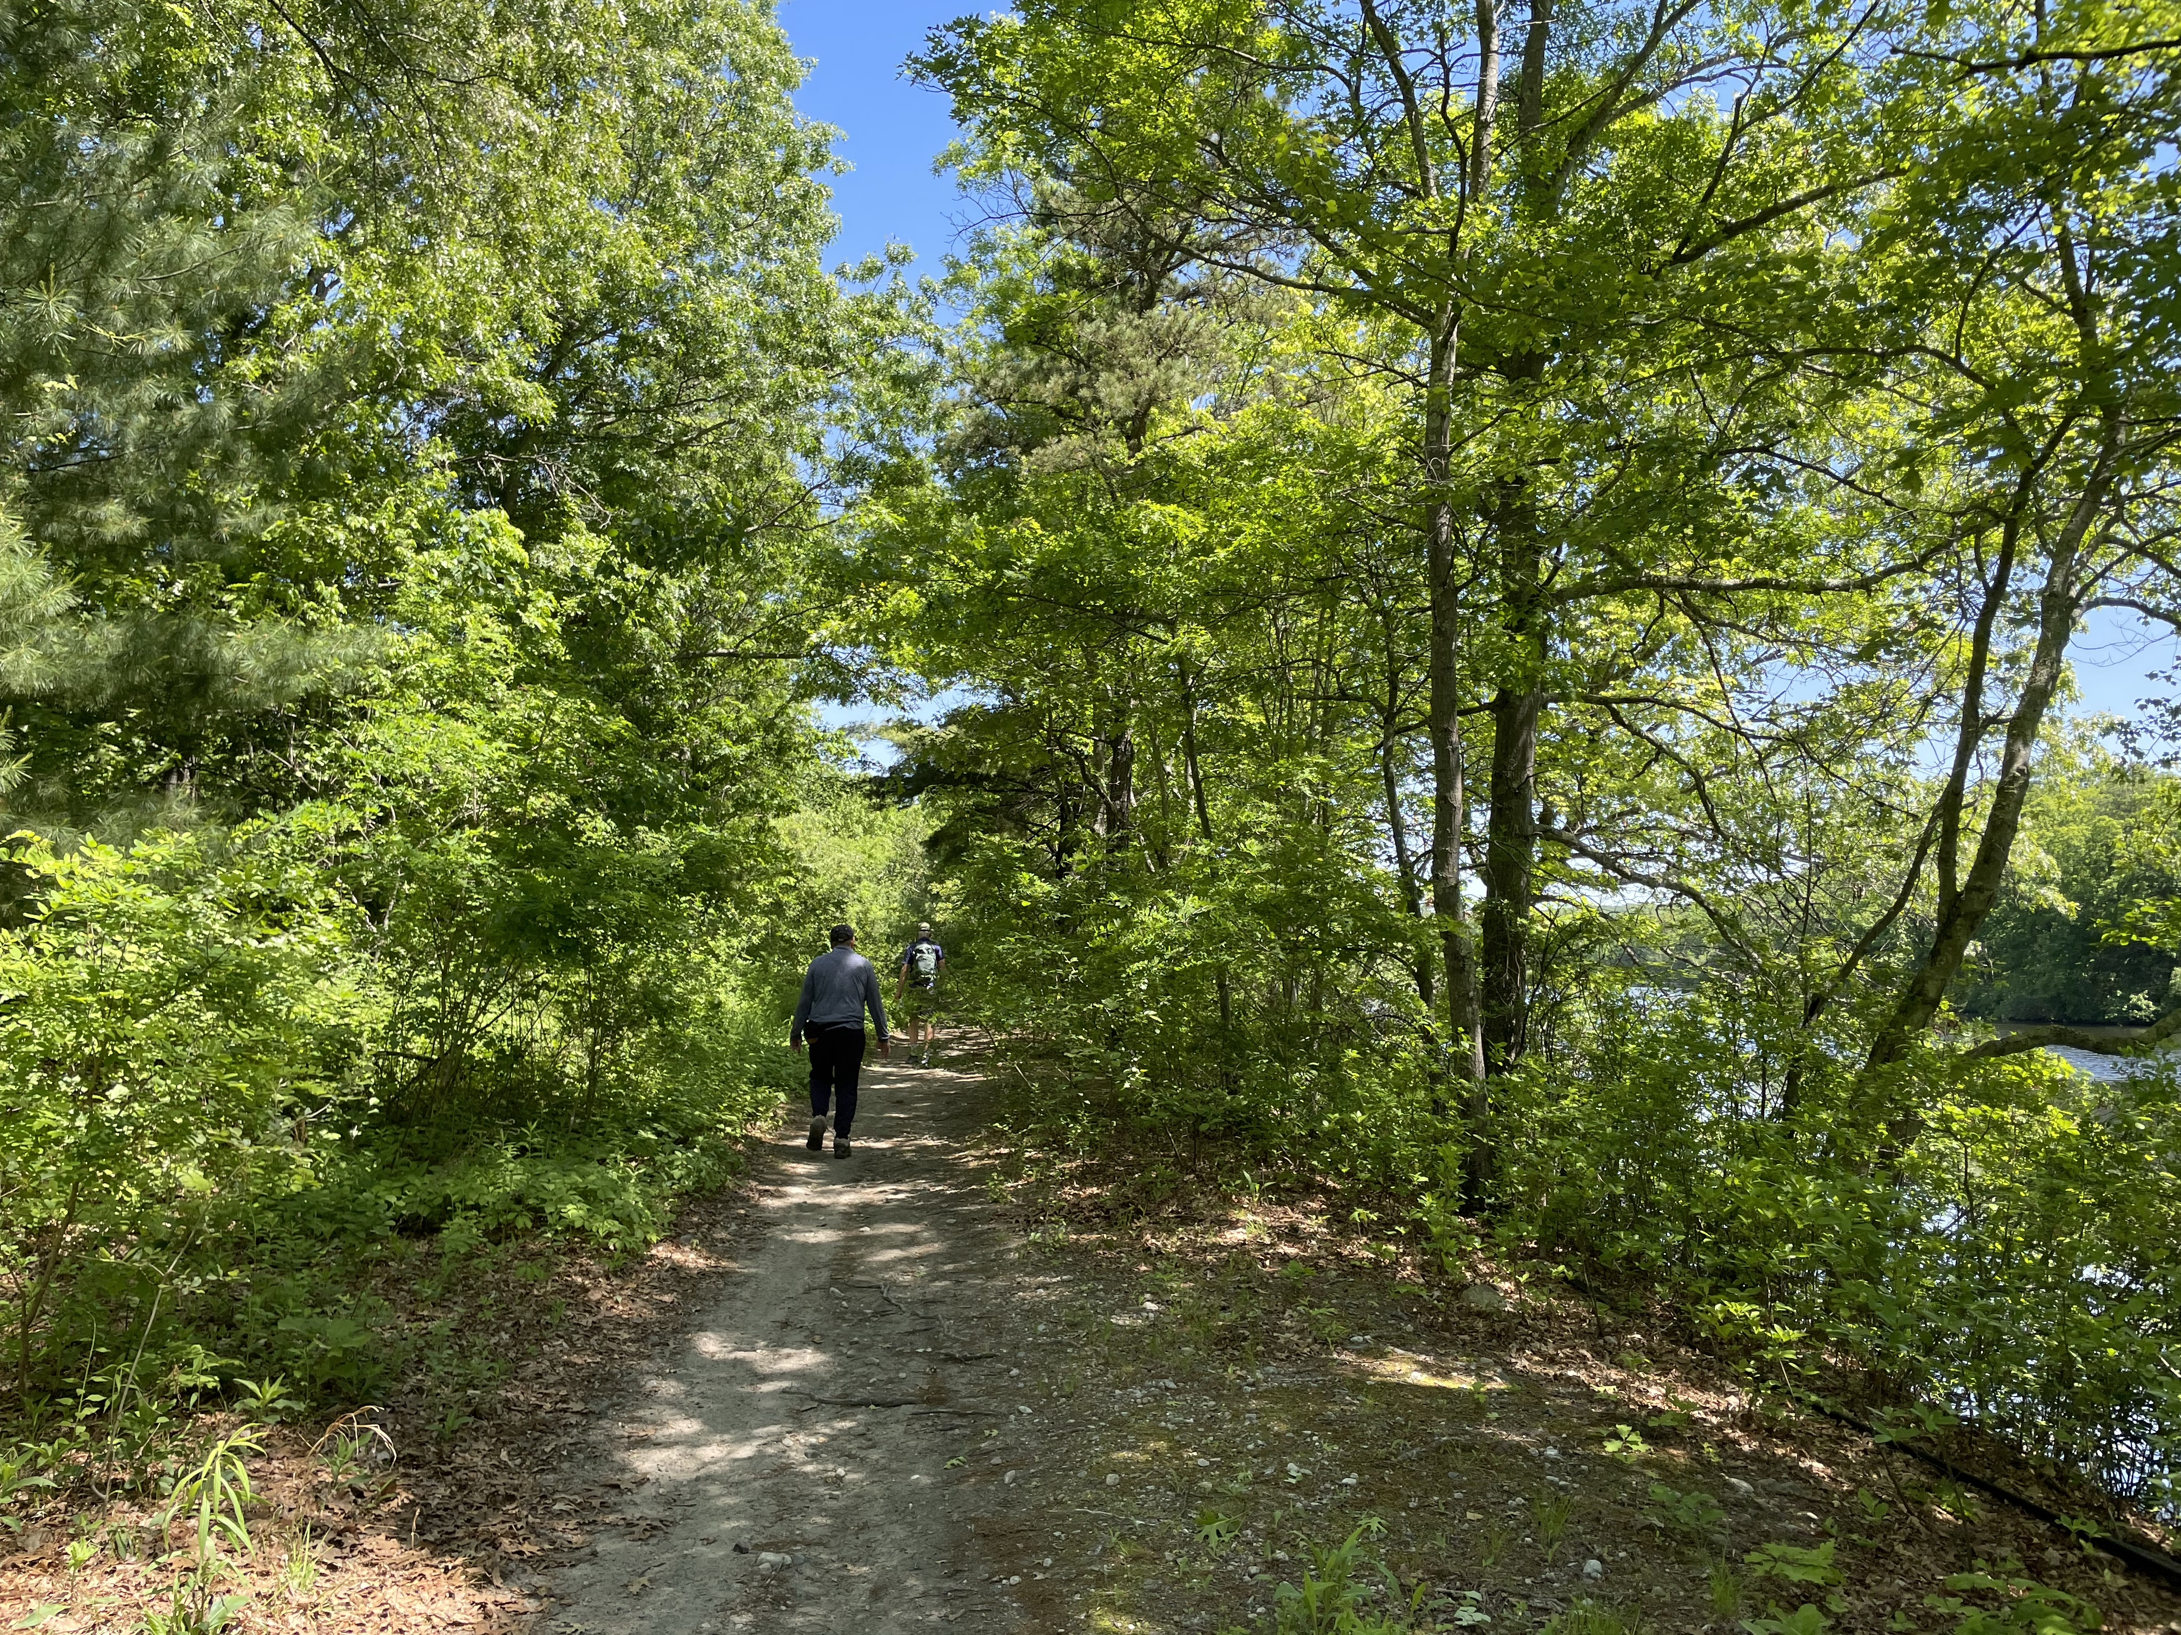
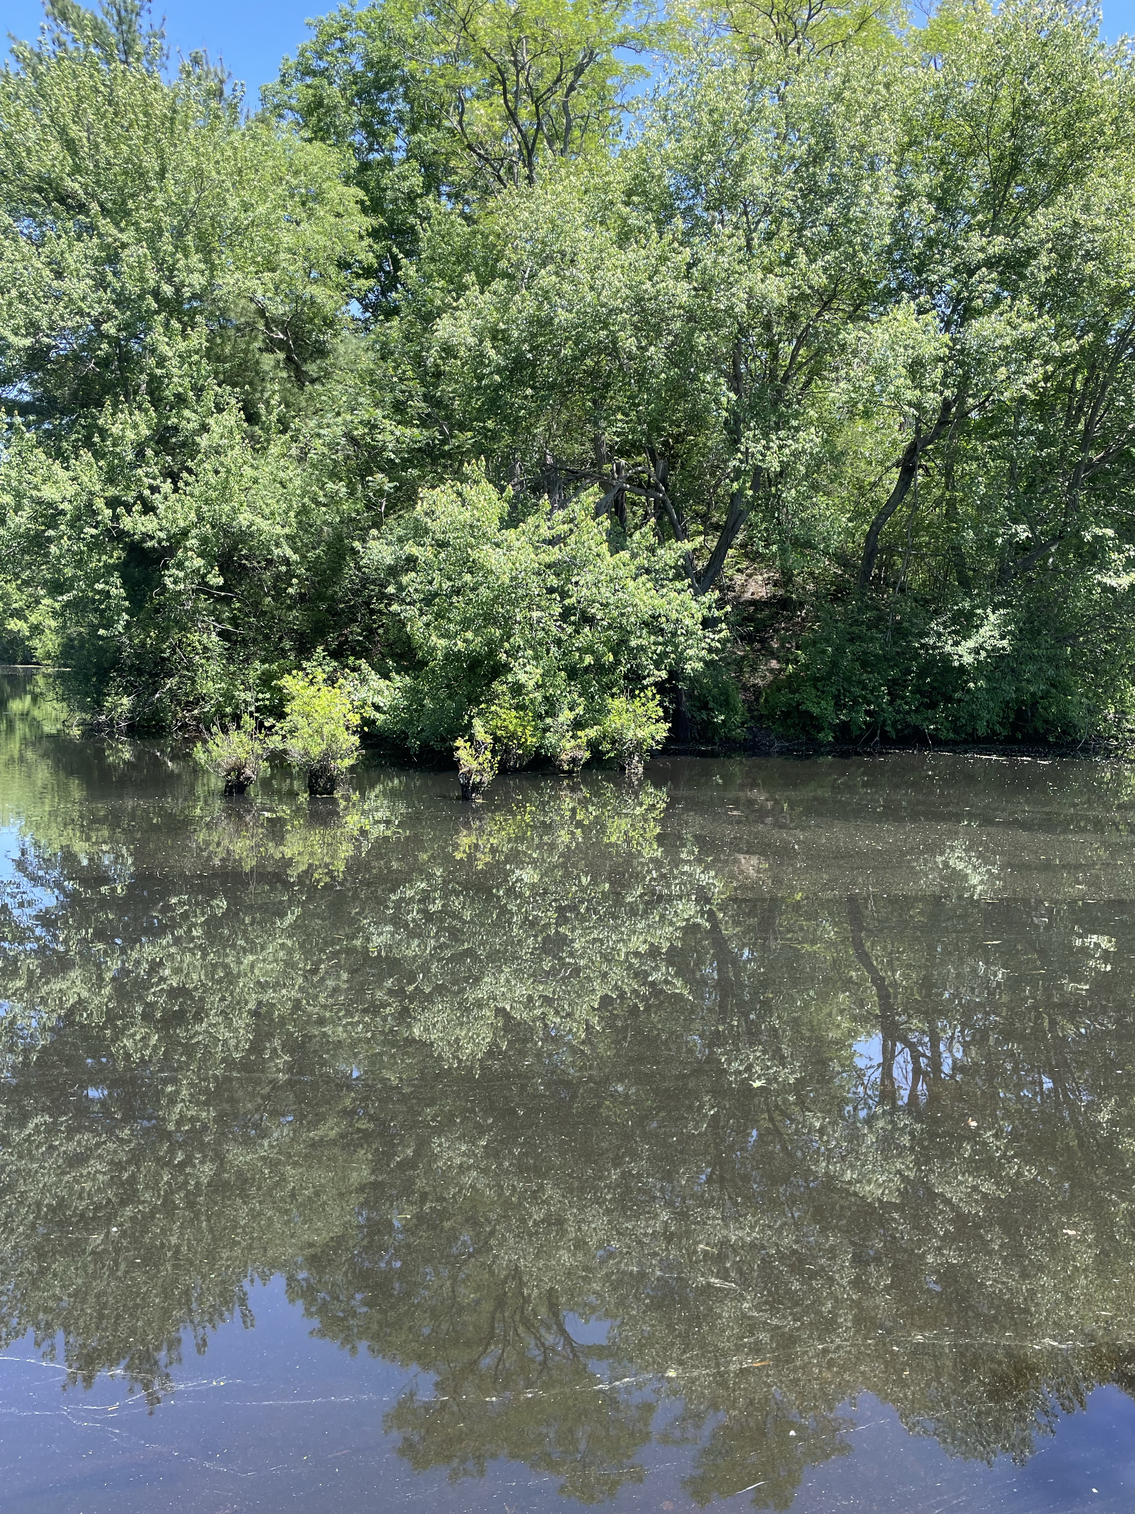
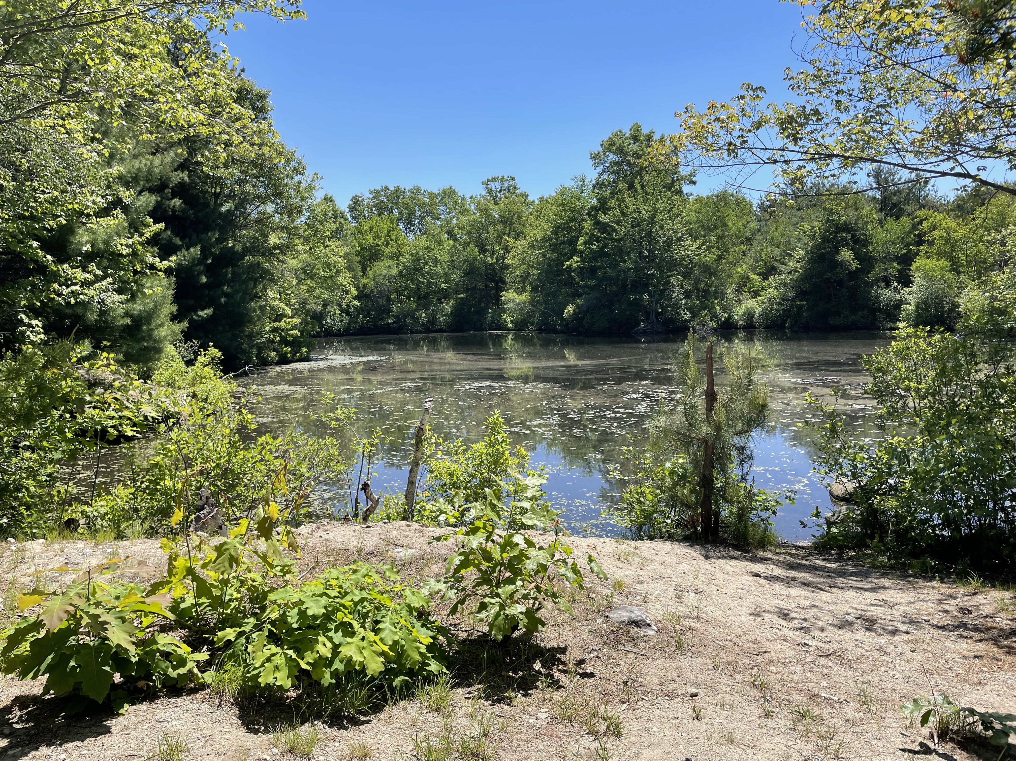
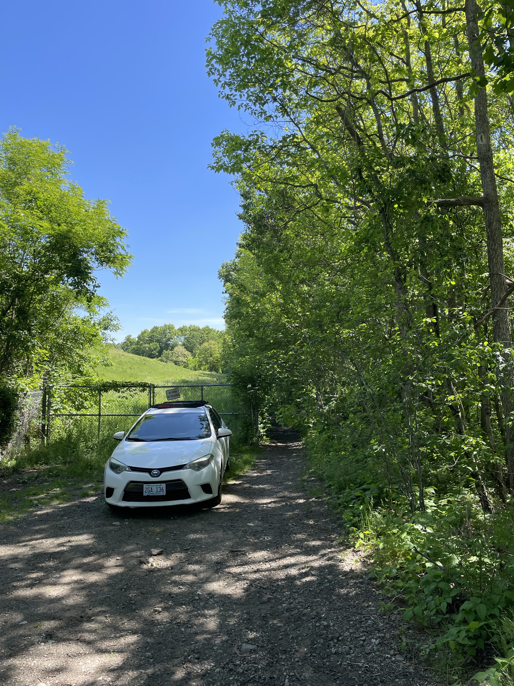
Blackstone

Slide 8
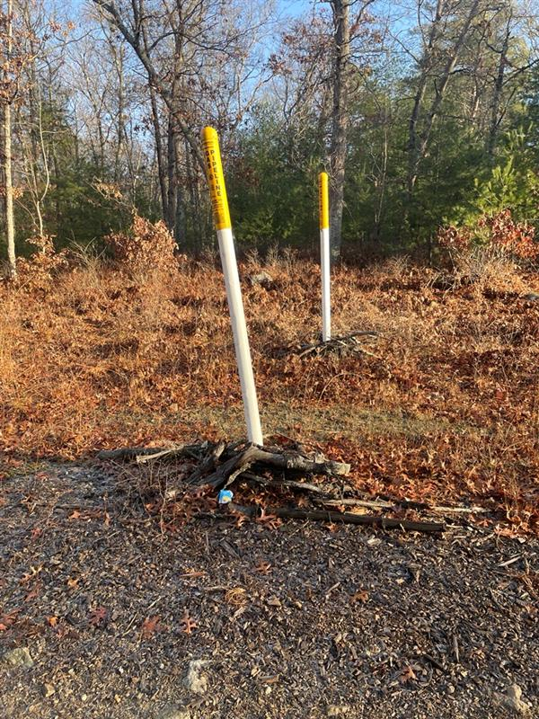
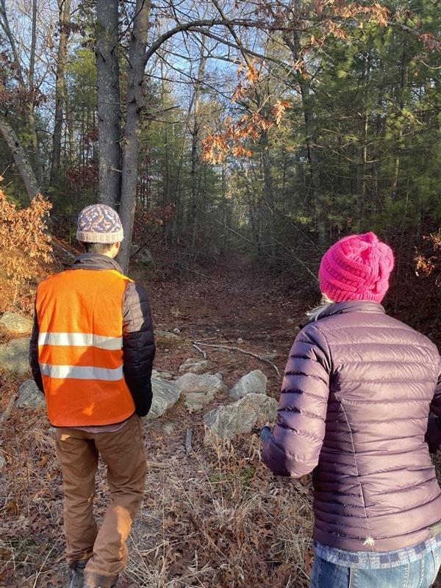
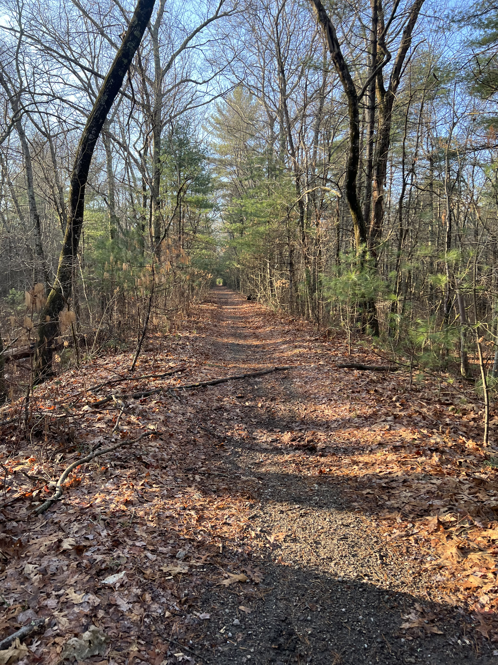
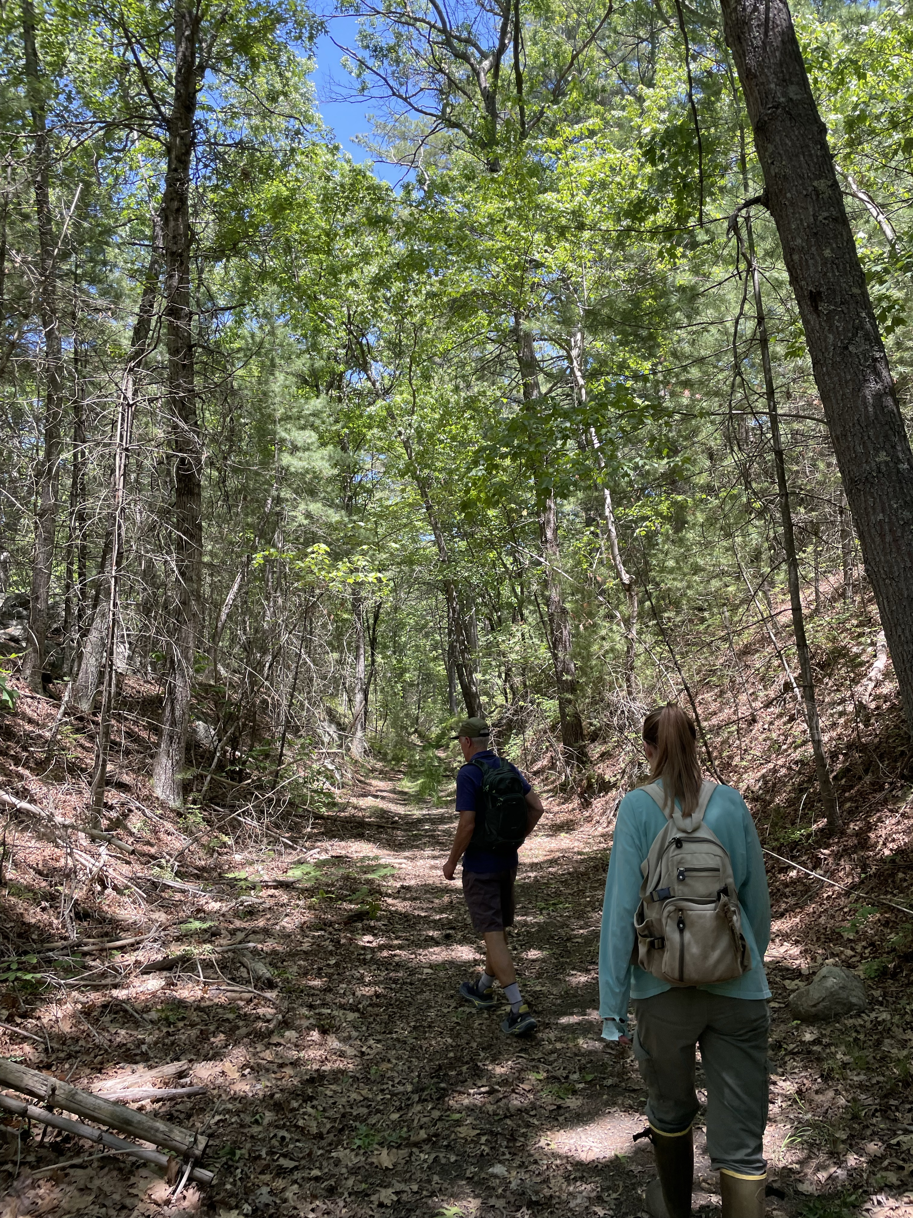
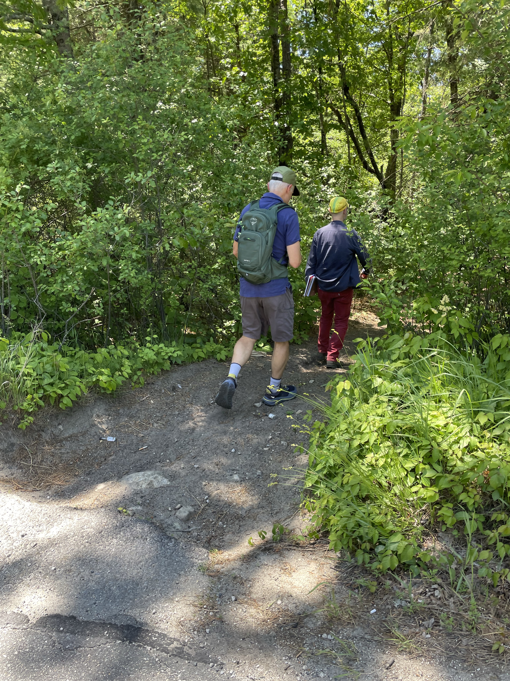
Mendon

Slide 9
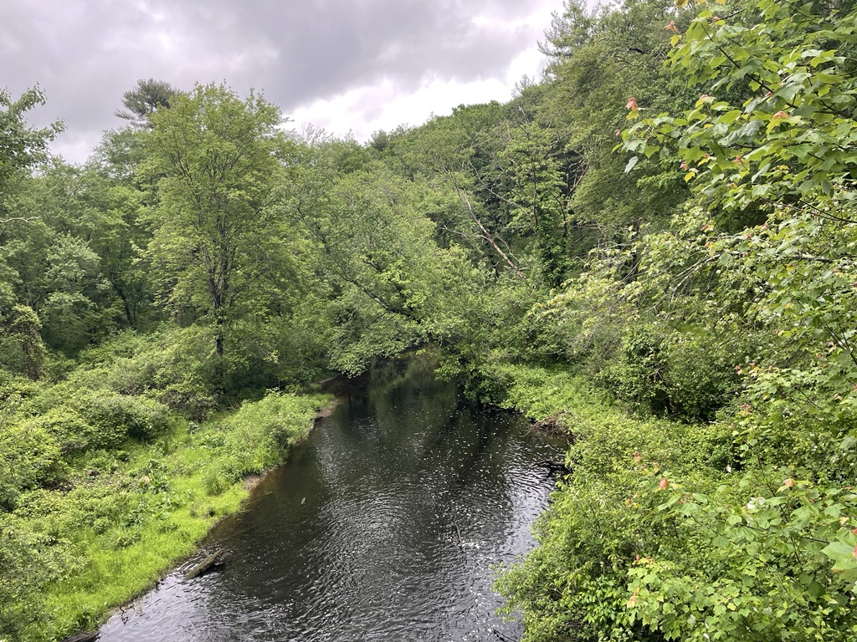
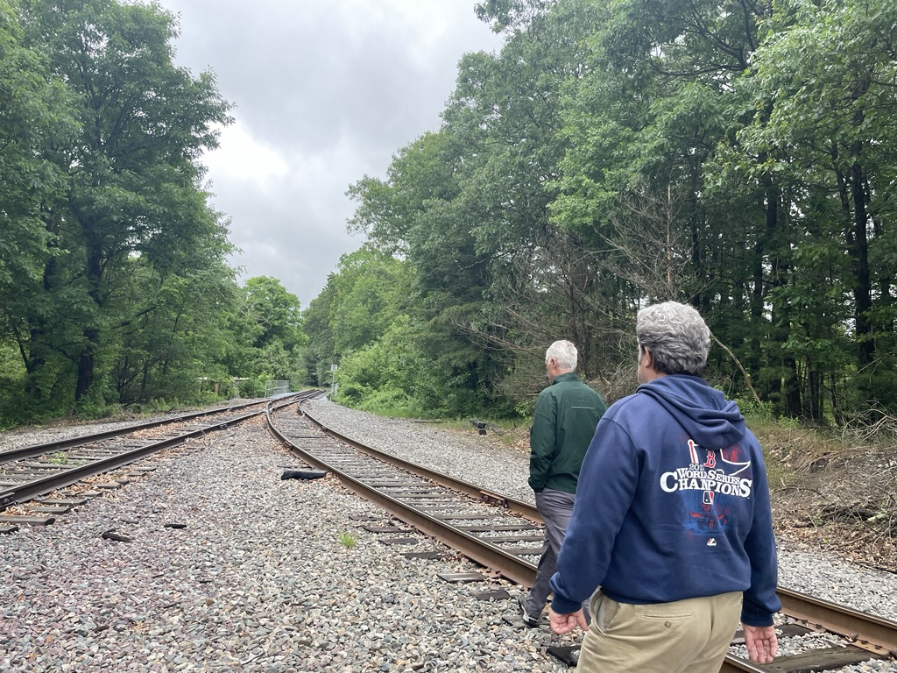
Bellingham

Slide 10
What's Next?
Bowman will be working on a Story Map with an existing Conditions Assessment coming soon.
CMRPC and the partner municipalities will be reaching out to landowners and stakeholders.
Later on, there will be public meetings in each town to receive comments, input and to get the word out.

Slide 11
Thank You
nlewis@cmrpc.org

