Slide 1
CMMPO
Public Participation Plan
FY2026 UPDATE
Overview of changes, new sections, and staff review items
prepared for alignment with the MassDOT PPP (October 2025)
★ New Sections
Staff Reviewed Items
↑ Updated Content
Central Massachusetts Regional Planning Commission
CMMPO Committee Meeting | May 20th, 2026

Slide 2






Why Are We Updating the PPP?
The FY2022 PPP needs to be refreshed to reflect new federal guidance, changing technology, and best practices
MassDOT PPP Update
Regulatory Updates
MassDOT released an updated PPP in October 2025. CMMPO must align with state guidance and incorporate new regulatory references.
New regulations added since 2022: MEPA EJ Protocol (2022), 40 CFR 51 update (2023), NEPA, Section 106, and updated 23 CFR 450 references.
Outdated Tools
Emerging Technology
Several platforms referenced in the FY2022 PPP are discontinued (Google Jamboard) or have changed significantly (virtual meeting platforms, survey tools).
Artificial intelligence presents new opportunities for public engagement and new risks that require proactive policy guidance.
Equity & Accessibility
Performance Monitoring
Stronger Environmental Justice framework, and new demographic tracking requirements.
Federal guidance expects MPOs to formally track and report on the effectiveness of their public participation processes.
CMMPO FY2026 Public Participation Plan — Update Overview

Slide 3
What's Changing — At a Glance
FY2026 PPP introduces new sections, updated content, and flags items requiring staff review before final adoption
4
9+
15+
Entirely New Sections
or Appendices
Sections Updated
or Expanded
Staff
Items Flagged and Reviewed
★ NEW
Brand-new content added to FY2026 PPP
↑ UPDATED
Existing content revised and expanded
STAFF REVIEW
Content that was flagged and reviewed
CMMPO FY2026 Public Participation Plan — Update Overview

Slide 4
Section 2: Background — Updated Regulatory Tables
↑ UPDATED | Expanded from 6 to 22+ law & regulation citations
What Was Added
⚠ Staff Reviewed
National Environmental Policy Act (NEPA), 1970
National Historic Preservation Act, Section 106
Rehabilitation Act of 1973, Sections 504 & 508
MEPA Public Involvement Protocol for EJ Populations (2022)
40 CFR 51 – Implementation Plans (updated July 2023)
23 CFR 450 Subparts B and C (explicit citation)
FHWA Public Hearings – 23 USC §128
FHWA Environmental Procedures – 23 CFR 771
Executive Order 13985 (Racial Equity, 2021) was included in the FY2022 PPP but dropped from MassDOT's 2025 PPP update, likely reflecting the current federal environment.
Carried Forward
Infrastructure Investment and Jobs Act (IIJA), 2021
Title VI of the Civil Rights Act of 1964
Americans with Disabilities Act of 1990 (ADA)
Civil Rights Restoration Act of 1987
MA Public Accommodation Law
EO 12898 – Environmental Justice
EO 13166 – Limited English Proficiency
Governor's Executive Order 526
CMMPO FY2026 Public Participation Plan — Update Overview

Slide 5
Section 4: Goals — 9th Goal Added
↑ UPDATED | All 8 existing goals retained; one new goal added to align with MassDOT 2025 PPP
Existing Goals — Retained & Refined
★ NEW — Goal 9
1. Meaningful Public Engagement
2. Increase Diversity
Provide Opportunities to Build Trust and Compromise
3. Ensure Accessibility
4. Provide Relevance
The CMMPO should ensure that discussions, particularly where there are conflicting views, are structured to allow for dialogue, compromise, and consensus.
Processes that allow for consensus to be achieved are critical to enabling public support for recommended transportation plans and actions.
The CMMPO recognizes that building trust with communities, especially those with historically adversarial relationships with transportation agencies, requires consistent and authentic engagement over time.
5. Foster Participant Satisfaction
6. Clearly Define Potential for Influence
7. Establish & Maintain Partnerships
8. Assess, Adapt, and Report
CMMPO FY2026 Public Participation Plan — Update Overview

Slide 6




Section 5: Self-Evaluation & Plan Modification
★ NEW | Formalizes the CMMPO's commitment to reviewing and improving its public participation practices
What This Section Establishes
6 Performance Metric Categories
Formal 3-year review cycle
Outreach & Attendance
Public Comment & Response
CMMPO staff, Advisory Committee, and public review the PPP at least every 3 years.
6 tracked metric categories
Accessibility & Accommodations
Impact on Decisions
Outreach, Comments, Accessibility, Impact on Decisions, Demographics, and Partnerships.
Demographic disaggregation
Performance data broken down by race, ethnicity, income, language, disability, and age.
Demographic Representation
Partnerships & Capacity
Documentation requirement
Every major planning document must include a public outreach summary report.
Aligns with: MassDOT PPP Section 1.1.1 (October 2025) and 23 CFR 450
CMMPO FY2026 Public Participation Plan — Update Overview

Slide 7




Section 6: Tools — New Additions & Staff Review Items
↑ UPDATED | New tools added; outdated platform references flagged for staff verification
★ New Tools Added
Staff Reviewed — Outdated Platforms
Postal Mail
Mapping Exercises
Google Jamboard:
Discontinued Jan 2025. Identify and document replacement whiteboard tool (FigJam, Miro, etc.).
Formal low-tech option for populations with limited digital access. Hard copies available on request.
In-person or online spatial input tools for infrastructure needs, safety, and project siting.
GoToMeeting:
Verify whether still in use alongside Zoom and Teams. Update platform list.
Poll Everywhere:
Public Involvement Plan (PIP)
Advisories & Alerts
Verify current polling tools in use (Zoom Polls, Mentimeter, etc.).
SurveyMonkey / Survey123 / Typeform:
Project-specific engagement strategy for major studies (LRTP, CPS). Standard template to be developed.
Urgent/time-sensitive communications, distinct from press releases.
Confirm which survey platforms are currently active subscriptions.
YouTube Channel:
Verify channel is current; confirm captions are up to date on all videos.
Scenario Planning
One-on-One Interactions
Brochures & Print Materials:
Review all brochures for outdated program, legislation, and contact info.
Structured trade-off exercises, particularly for LRTP and corridor studies.
Formal recognition of direct staff-to-stakeholder engagement as a documented method.
Social Media Platforms:
Update platform list to reflect current accounts; verify Hootsuite/ArchiveSocial.
StreetMix:
Confirm tool is still in active use; note any additional visualization tools adopted.
CMMPO FY2026 Public Participation Plan — Update Overview

Slide 8
Section 7: Methods — New Methods & Review Items
↑ UPDATED | Three new formal engagement methods added; committee and platform info needs review
★ New Formal Methods Added
Staff Reviewed
One-on-One Interactions
Non-CMMPO Committees & Workgroups:
Reviewed and updated the list of committees where staff participate. Membership may have changed since FY2022.
Formally recognizes planned and spontaneous direct staff-to-stakeholder engagement. Staff encouraged to document input received.
Virtual Meeting Platforms:
GoToMeeting referenced in FY2022. Verified which platforms are currently active. Updated feature descriptions.
Public Involvement Plan (PIP)
Project-specific engagement strategy for major planning efforts. Standard template to be developed for consistency across projects.
Hybrid Meeting Equipment:
Verified Meeting Owl Pro is still in use and confirm current platform integration.
Underrepresented Populations Strategy:
Scenario Planning Exercises
Updated with specific examples from recent outreach efforts and new strategies since FY2022.
Structured exercises that help stakeholders evaluate trade-offs. Particularly for LRTP updates and major corridor studies.
CMMPO/Advisory Committee Details:
Verify current meeting times, locations, and Bylaws references.
CMMPO FY2026 Public Participation Plan — Update Overview

Slide 9
New Appendix A: Planning Document Public Participation Guidelines
★ NEW | Formalizes minimum comment periods, amendment processes, and update frequencies for all plan types
For the first time, the CMMPO PPP includes a formal table of minimum public participation standards for every planning document type.
Plan Type | Min. Comment Period | Amendment Process | Update Frequency
Long-Range Transportation Plan (LRTP) | 45 days (23 CFR 450.316) | Admin: CMMPO vote. Significant: 21-day public comment + CMMPO vote. | Every 4 years
Transportation Improvement Program (TIP) | 21 days | Admin modifications: no comment required. Amendments: 21 days. | Annual
Unified Planning Work Program (UPWP) | 21 days | Advisory Committee review + CMMPO vote; website notice. | Annual
Corridor Profile Studies (CPS) | 21–30 days | N/A (single study document) | As needed
Modal Plans | 21–30 days | N/A (single study document) | As needed
Public Participation Plan (PPP) | 45 days | Significant: 45 days + CMMPO adoption. Minor: Advisory Committee + CMMPO vote. | At least every 3 years
★ All minimum periods are guidelines. Staff are encouraged to exceed them wherever feasible.
CMMPO FY2026 Public Participation Plan — Update Overview

Slide 10


New Appendix B: Staff Guide to Planning Public Engagement
★ NEW | 7-step internal protocol for meeting Title VI and ADA requirements in all public outreach activities
1. Know Your Audience
2. Build Outreach Strategy
Use demographic tools (EJScreen, REJ+, ACS, ETC Explorer) to identify impacted populations before planning outreach.
Define what you're sharing, what feedback you need, and how to reach diverse populations through multiple channels.
3. Location & Time
4. Coordinate Notice
Select ADA-accessible venues within ¼ mile of WRTA/MBTA stops. Consider evening and weekend meetings.
Minimum 21-day notice; 30 days for major events. Use CMRPC notice template. Distribute to minority-serving media.
5. Prepare for Meeting
6. During the Meeting
Plain-language materials. ADA-accessible documents. Test all technology 1 business day in advance.
Announce all services at the start. Document all comments. Support language interpretation channels.
7. After the Meeting
Compile comments, post recordings and materials. Document how input was used — this is a civil rights obligation.
★ Demographic equity tools (Step 1): EJScreen, MassDOT REJ+, CTPS Tool, ETC Explorer, CDC SVI, ACS data
CMMPO FY2026 Public Participation Plan — Update Overview

Slide 11

New Section 10: Using Artificial Intelligence for Community Engagement
★ NEW | First MPO PPP section in the region to address AI tools for public engagement
The FY2026 PPP introduces formal guidance on how the CMMPO may use — and must safeguard — AI tools in its public engagement work.
Potential Applications
Six Guardrails & Ethical Principles
Plain Language & Translation
Human Oversight
Transparency
AI drafts plain-language summaries and translation drafts — all reviewed by CMRPC staff before distribution.
AI assists staff, never replaces judgment. All outputs are reviewed before use.
CMMPO discloses AI tool use. Public always has human escalation option.
Comment Analysis
AI organizes and categorizes large volumes of public comments; staff validate before use in planning documents.
Outreach Targeting
Equity & Bias Review
Data Privacy
AI analyzes demographic data to identify underrepresented communities and improve targeted outreach strategies.
Regular review of AI outputs for bias in outreach reach and characterization.
Personally identifiable information not submitted to external AI platforms.
Accessibility Tools
AI-powered captioning, transcription, and audio description tools to support ADA and Section 504 compliance.
Accessibility
Ongoing Evaluation
AI tools must themselves be accessible to people with disabilities and LEP.
AI tool impacts monitored through self-evaluation process (Section 5).
CMMPO FY2026 Public Participation Plan — Update Overview

Slide 12
New Appendices C & D: Public-Facing Guides
★ NEW | Two new appendices to help the public navigate CMMPO processes and virtual meetings
Appendix C — Frequently Asked Questions
Appendix D — How to Access Virtual Meetings
12 public-facing Q&A entries covering:
11 Q&A entries covering:
What is the CMMPO?
What is the LRTP / TIP / UPWP?
What is a Corridor Profile Study?
How can I provide feedback on plans?
How do I request accommodations?
How can I stay informed about meetings?
What is Environmental Justice?
How are projects selected for funding?
Who do I contact about a specific issue?
Can I participate if I can't attend a meeting?
What platform does the CMMPO use? (Zoom)
Do I need an account or software?
Do I have to join by video?
How do I find upcoming virtual meetings?
Do I need to register in advance?
How do I request accessibility services?
How do I provide a public comment?
Are meetings recorded?
What if I have technical difficulties?
What if I can't attend at all?
Low-tech options (phone, mail, library)
CMMPO FY2026 Public Participation Plan — Update Overview

Slide 13
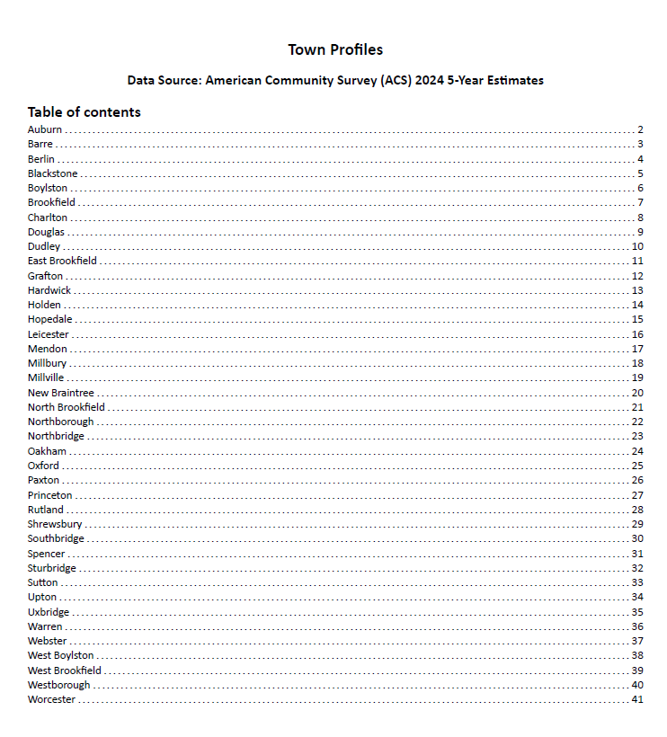
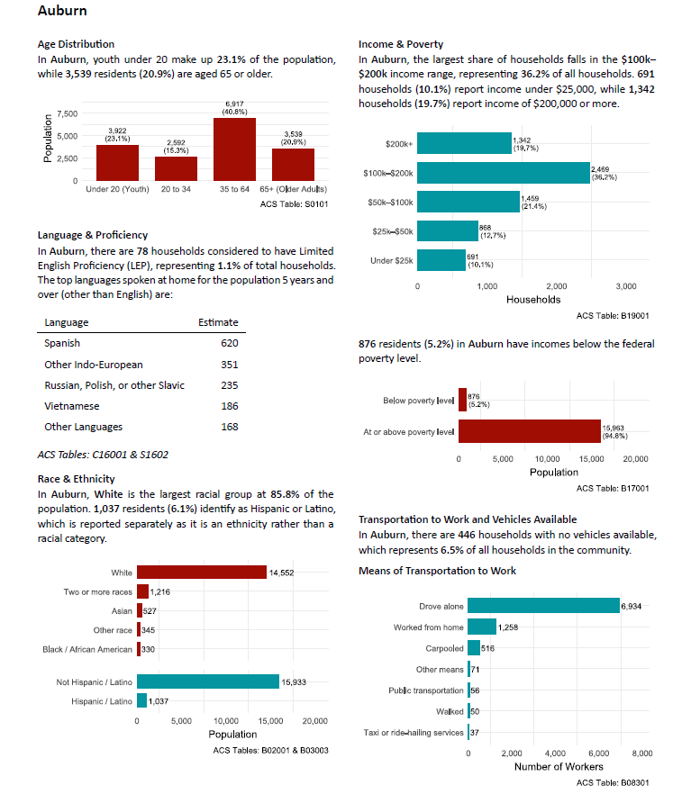
New Appendices E: Municipality Demographic Data
★ NEW | Municipal Demographic Data appendix to help the CMMPO understand their communities better before starting a project.
CMMPO FY2026 Public Participation Plan — Update Overview

Slide 14
Next Steps
Before the FY2026 PPP is finalized and adopted by the CMMPO
CMMPO Presentation
CMMPO Advisory Committee Review
1
2
Present the draft PPP to the CMMPO for review and recommendations.
Present the draft PPP to the Advisory Committee for review and recommendation to the CMMPO.
45-Day Public Comment Period
CMMPO Endorsement
3
4
Per 23 CFR 450, the draft FY2026 PPP must be made available for a minimum 45-day public comment period before CMMPO adoption.
Schedule formal endorsement of the FY2026 PPP at a CMMPO meeting. Update endorsement sheet with meeting date and chair signature.

Slide 15
Thank You
For any questions or comments please email: nlewis@cmrpc.org

